Slide 1
Forging Die casting
Introduction/objectives
Classification of forging processes
      Hammer or drop forging
      Press forging
      Open-die forging
      Closed-die forging
Calculation of forging loads
Effect of forging on microstructure
Residual stresses in forgings
Typical forging defects

Slide 2
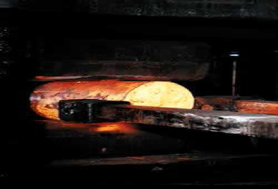
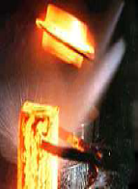
Introduction
Forging is the working of metal into a useful shape by hammering or pressing.
The oldest of the metalworking arts (primitive blacksmith).

Slide 3
Replacement of machinery occurred during early the Industrial revolution.
Forging machines are now capable of making parts ranging in size of a bolt to a turbine rotor.
Most forging operations are carried out hot, although certain metals may be cold-forged.

Slide 4
Forging operations
Edging is used to shape the ends of the bars and to gather metal. The metal flow is confined in the horizontal direction but it is free to flow laterally to fill the die.
Drawing is used to reduce the cross-sectional area of the work piece with concurrent increase in length.
Piercing and punching are used to produce holes in metals.
Fullering is used to reduce the cross-sectional area of a portion of the stock. The metal flow is outward and away from the centre of the fuller.
i.e., forging of connecting rod for an internal combustion engine.
Swaging is used to produce a bar with a smaller diameter (using concave dies).

Slide 5
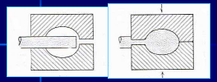
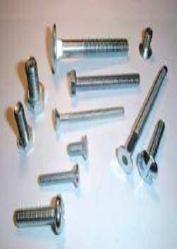
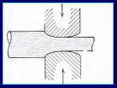
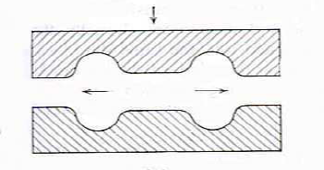

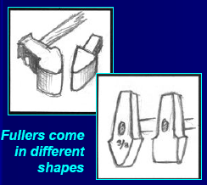
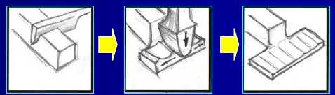
Edging
Drawing
Piercing
Fullering
Fuller move fast and moves metal
perpendicular to the face

Slide 6
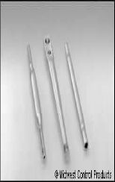

Swaging is a special type of forging in which metal is formed by a succession of rapid hammer blows
Swaging provides a reduced round cross section suitable for tapping, threading, upsetting or other subsequent forming and machining operations.
Swaging at the ends, ready for next forming process.

Slide 7
Classification of forging processes
By equipment
1) Forging hammer or drop hammer
2) Press forging
By process
1) Open - die forging
2) Closed - die forging

Slide 8
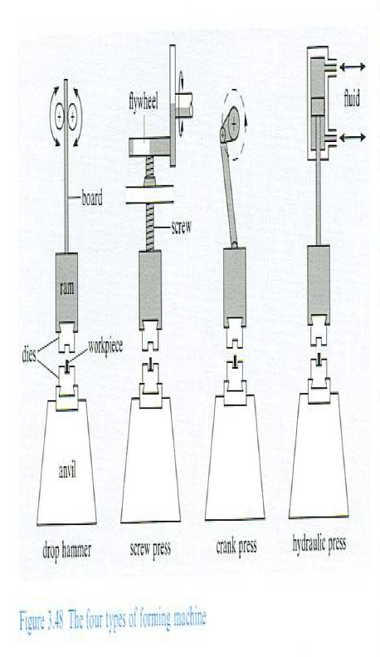
Forming machines
There are four basic types of forging machines

Slide 9
Hammer and press forging processes
Forging hammers
There are two basic types of forging hammers used;
Board hammer
Power hammer
Forging presses
There are two basic types of forging presses available;
Mechanical presses
Hydraulic presses

Slide 10
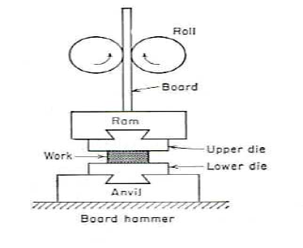
Board hammer –forging hammer
• The upper die and ram are raised by friction rolls gripping the board.
• After releasing the board, the ram falls under gravity to produce the blow energy.
• The hammer can strike between 60-150 blows per minute depending on size and capacity.
• The board hammer is an energy restricted machine. The blow energy supplied equal the potential energy due to the weight and the height of the fall.
Potential energy = mgh
This energy will be delivered to the
metal work piece to produce plastic deformation.

Slide 11
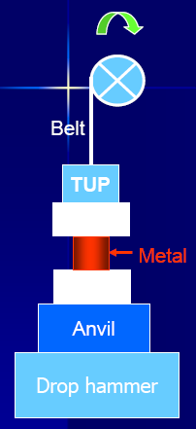
Forging hammer or drop hammer
Provide rapid impact blows to the surface of the metal.
Dies are in two halves
Lower : fixed to anvil
Upper : moves up and down with the TUP.
Energy (from a gravity drop) is adsorbed onto the metal, in which the maximum impact is on the metal surface.
Dies are expensive being accurately machined from special alloys (susceptible to thermal shock).
Drop forging is good for mass production of complex shapes.

Slide 12
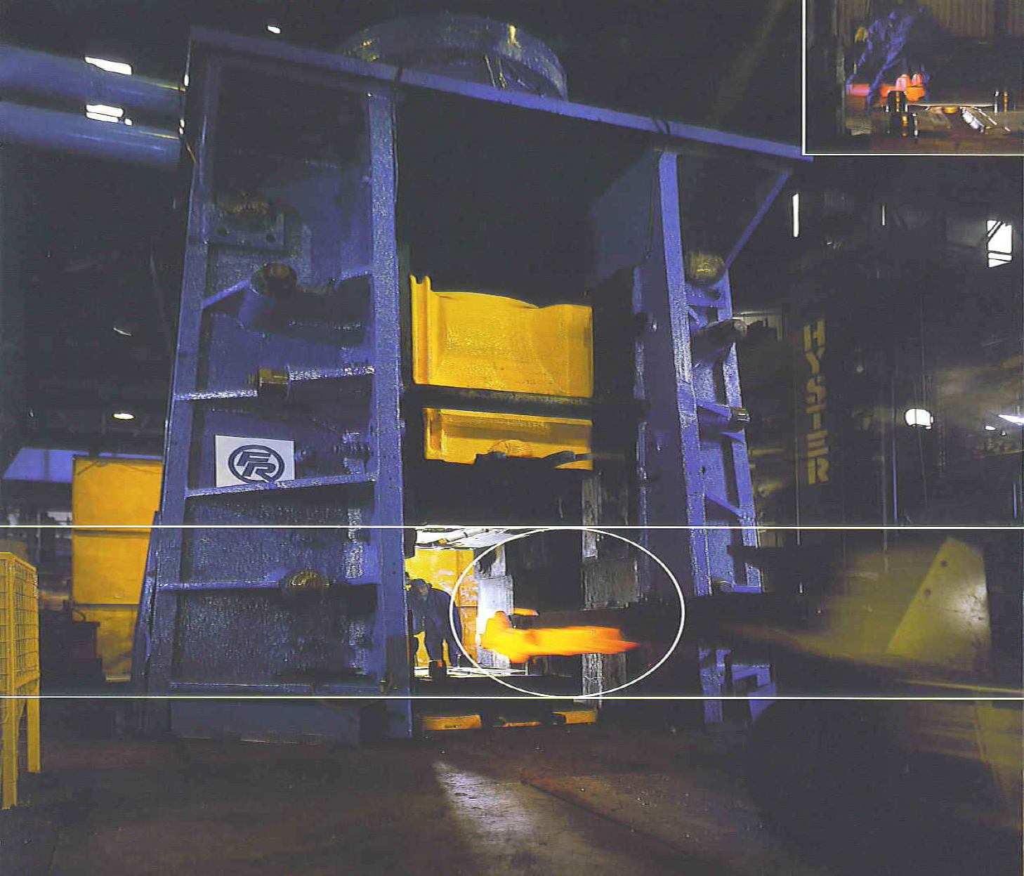
Example: Forging hammer or drop hammer
The energy supplied by
the blow is equal to the
potential energy due to
the weight of the ram and the height of the fall.
Potential energy = mgh

Slide 13
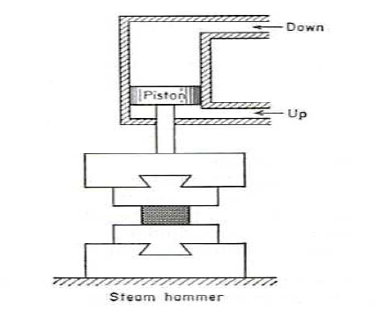

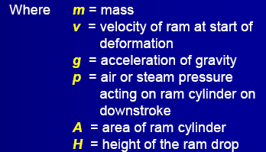
Power hammer
Power hammer provides greater
capacity, in which the ram is accelerated
on the down stroke by steam or air pressure
in addition to gravity.
• Steam or air pressure is also used to raise
the ram on the upstroke.
• The total energy supplied to the blow
in a power drop hammer is given by

Slide 14
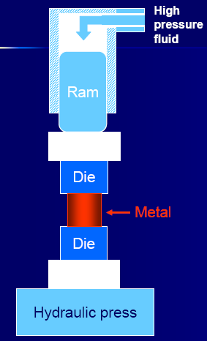
Hydraulic press forging
Using a hydraulic press or a mechanical press to forge the metal, therefore, gives continuous forming at a slower rate.
• Provide deeper penetration.
• Better properties (more homogeneous).
• Equipment is expensive.

Slide 15
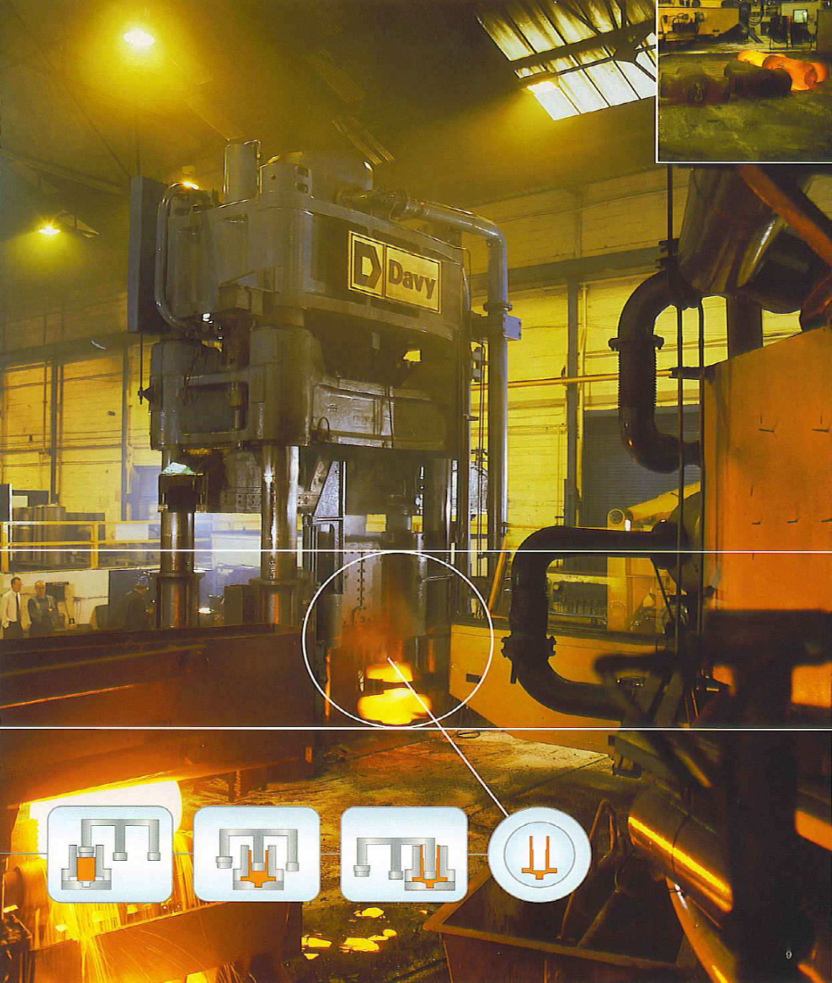
Example: Hydraulic Press forging
• Hydraulic presses are load restricted machines in which hydraulic pressure moves a piston in a cylinder.
• The full press load is available at any point during the full stroke of the ram. Therefore, hydraulic presses are ideally suited for extrusion-type forging operation.
• Due to slow speed, contact time
is longer at the die-metal Interface,
which causes problems such as
heat lost from work piece and die
deterioration.
• Also provide close-tolerance forging.
• Hydraulic presses are more
expensive than mechanical presses
and hammers.

Slide 16
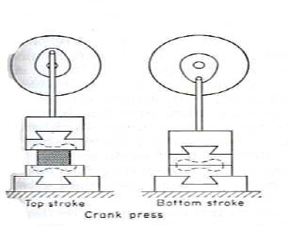

Mechanical press forging
• Crank press translates rotary motion into reciprocating linear motion of the press slide.
• The ram stroke is shorter than in a hammer or hydraulic press.
• Presses are rated on the basis of the force developed at the end of the stroke.
• The blow press is more like squeeze than like the impact of the hammer, therefore, dies can be less massive and die life is longer than with a hammer.
• The total energy supplied during the stroke of a press is given by

Slide 17
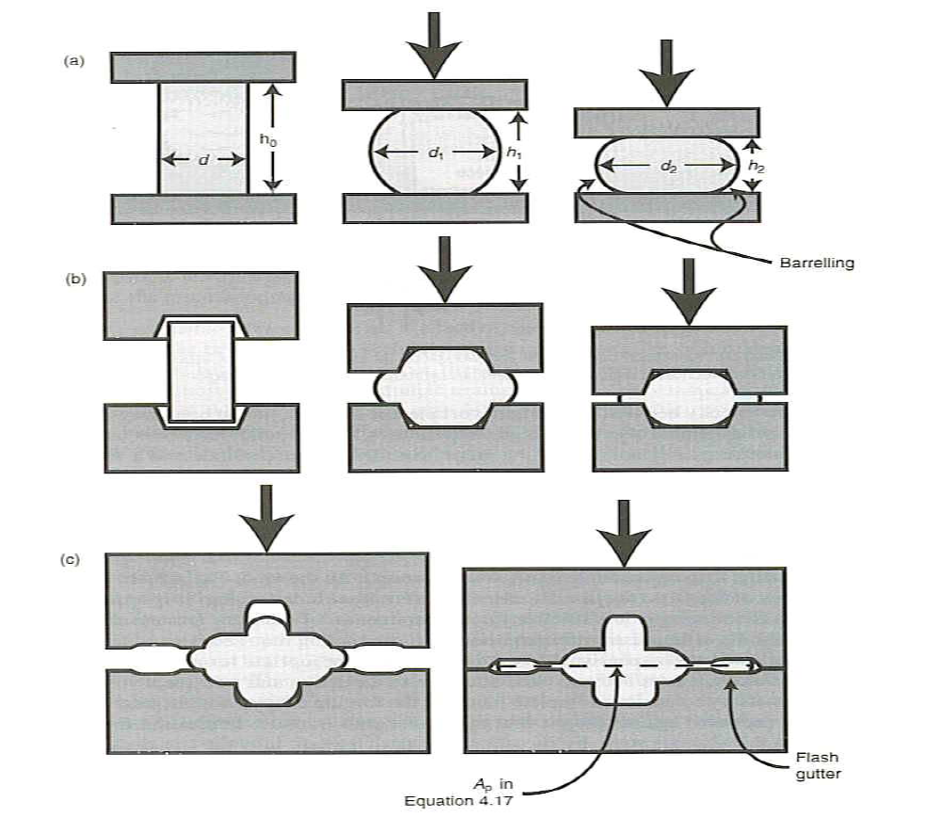
Closed and open die forging processes
Open-die forging
Closed-die forging
Impression-die forging

Slide 18
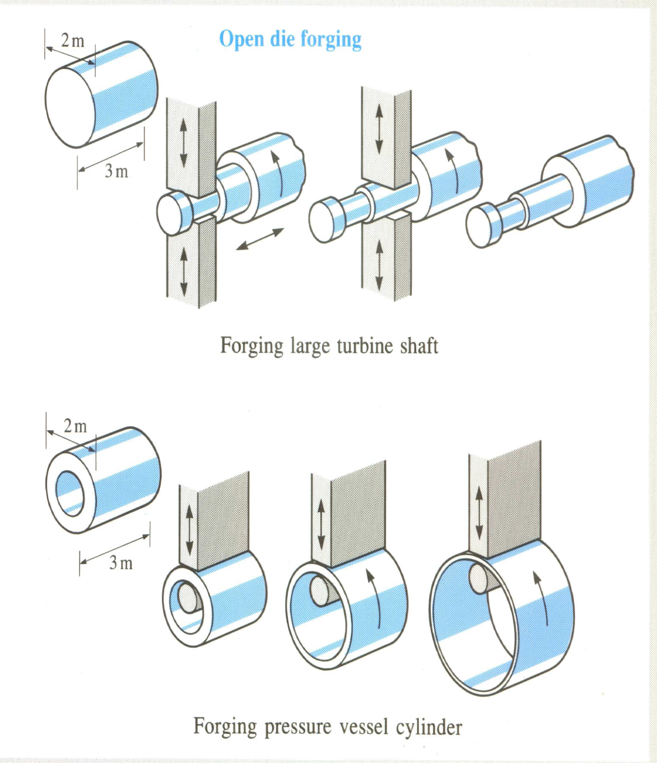
Open-die forging
• Open-die forging is carried out between flat dies or dies of very simple shape.
• The process is used for
mostly large objects or when the number of parts produced is small.
• Open-die forging is often used to preform the workpiece for closed-die forging.

Slide 19
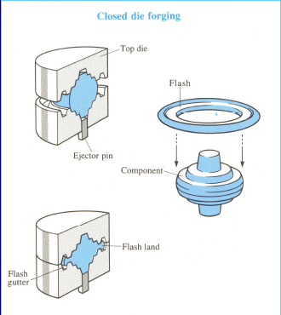
Closed-die forging (or impression-die forging)
The work piece is deformed between two die halves which carry the impressions of the desired final shape.
• The work piece is deformed under high pressure in a closed cavity.
• The process provide precision forging with close dimensional tolerance.
• Closed dies are expensive.

Slide 20
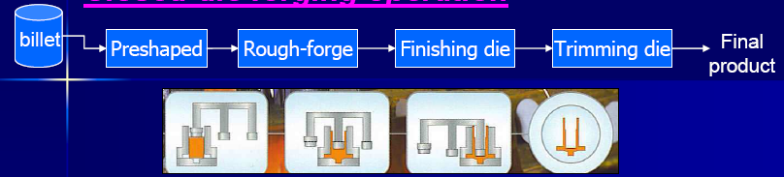
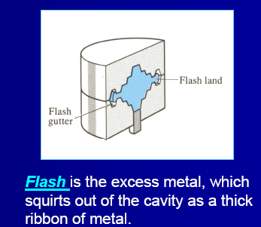
Closed-die forging operation

Slide 21
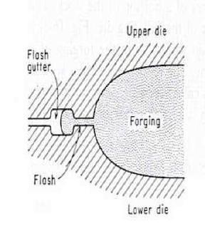
Functions of flash
The flash serves two purposes:
• Acts as a ‘safety value’ for excess metal.
• Builds up high pressure to ensure that the metal fills all recesses of the die cavity.
Remark: It is necessary to achieve complete filling of the forging cavity without generating excessive pressures against the die that may cause it to fracture.

Slide 22
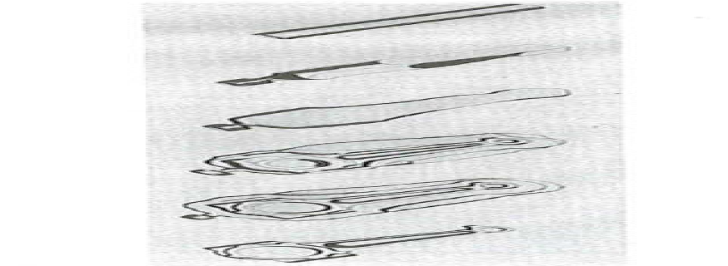
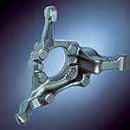
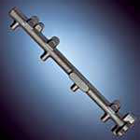
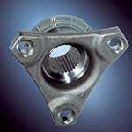
Example: Die set and forging steps for the manufacturing of an automobile engine connecting rod
Performing of a round piece in an open die arrangement.
• Rough shape is formed using a block die.
• The finishing die is used to bring the part to final tolerances and surface finish.
• Removal of flash (excess metal).
Steering knuckle
Rail
Flange

Slide 23
Die materials
Required properties
Die materials: alloyed steels (with Cr,Mo, W, V), tool steels, cast steels or castiron. (Heat treatments such are nitriding or chromium plating are required to improve die life)
Thermal shock resistance
• Thermal fatigue resistance
• High temperature strength
• High wear resistance
• High toughness and ductility
• High hardenability
• High dimensional stability during hardening
• High machinability
Note:1) Carbon steels with 0.7-0.85% C are appropriate for small tools and flat impressions.
2) Medium-alloyed tool steels for hammer dies.
3) Highly alloyed steels for high temperature resistant dies used in presses and horizontal forging machines.

Slide 24
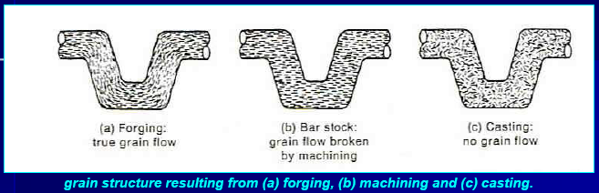
Effect of forging on microstructure
• The formation of a grain structure in forged parts is elongated in the direction of the deformation.
• The metal flow during forging provides fibrous microstructure (revealed by etching). This structure gives better mechanical properties in the plane of maximum strain but (perhaps) lower across the thickness.
• The workpiece often undergo re crystallisation, therefore, provide finer grains compared to the cast dendritic structure resulting in improved mechanical properties.

Slide 25

Typical forging defects
Incomplete die filling.
Die misalignment.
Forging laps.
Incomplete forging penetration- should forge on the press.
Micro structural differences resulting in pronounced property variation.
Hot shortness, due to high sulphur concentration in steel and nickel.
Pitted surface, due to oxide scales occurring at high temperature stick on the dies.

Slide 26
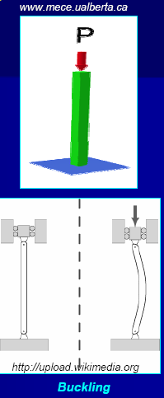
Typical forging defects
Buckling, in upsetting forging. Subject to high compressive stress.
Surface cracking, due to temperature differential between surface and centre, or excessive working of the surface at too low temperature.
Microcracking, due to residual stress.

Slide 27
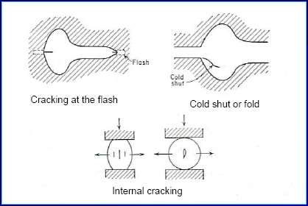
Typical forging defects
Flash line crack, after trimming-occurs more often in thin
Work pieces. Therefore should increase the thickness of the flash.
Cold shut or fold , due to flash or fin from prior forging steps is forced into the work piece.
Internal cracking, due to secondary tensile stress.

Slide 28
Thank you

